Slide 1


Slide 2

Online Job Portal for Alumni Network

Slide 3
Group Member Introduction:
VU ID : BC210426295
STUDENTNAME : (Shahroz Pervez)

Slide 4
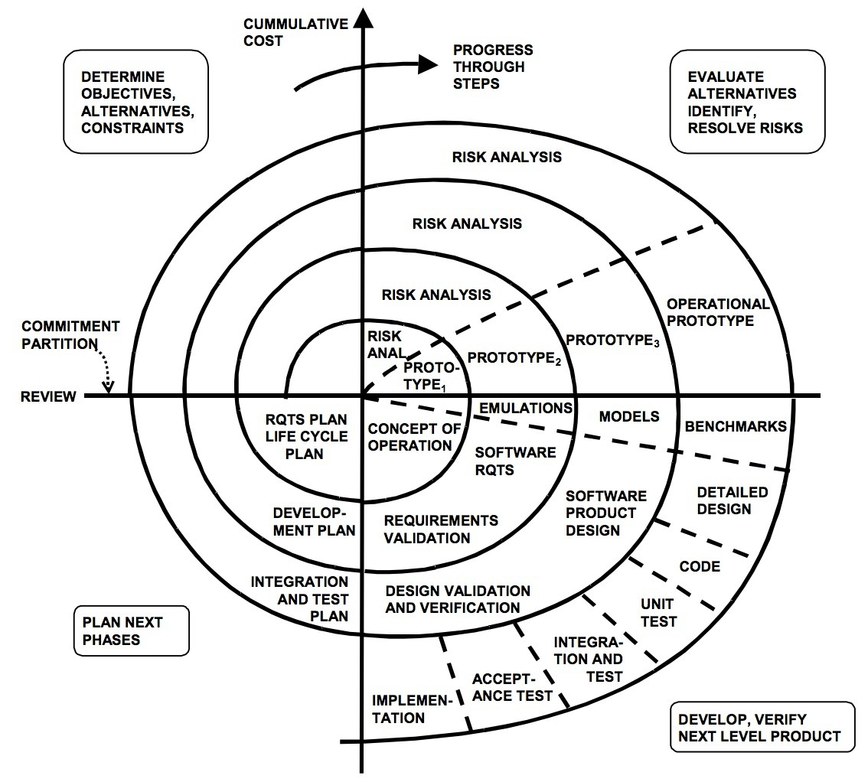
Spiral Model

Slide 5
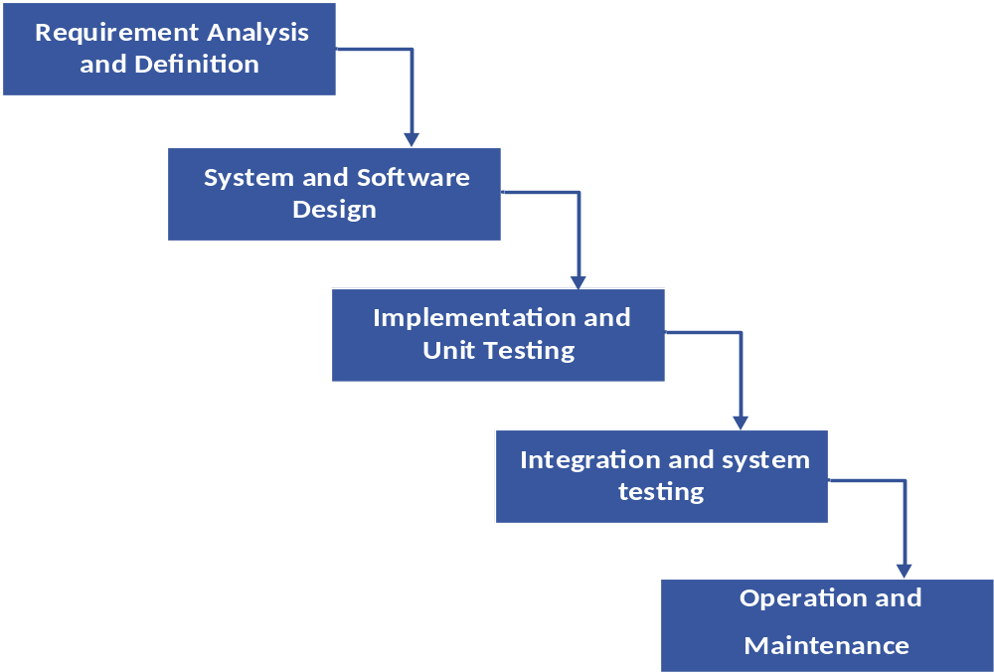
WATER FALL MODEL

Slide 6
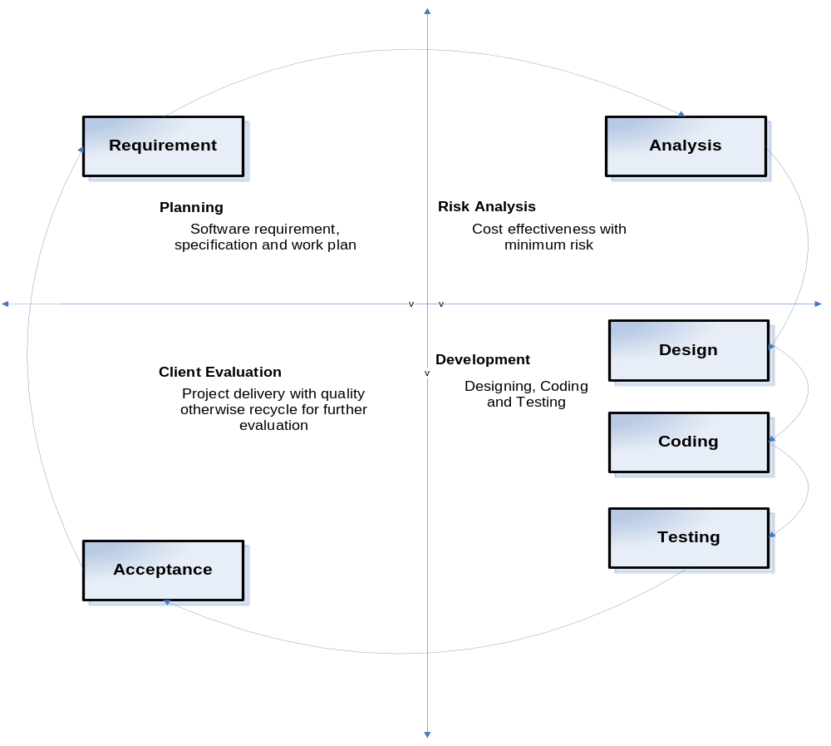
VU PROCESS MODEL

Slide 7
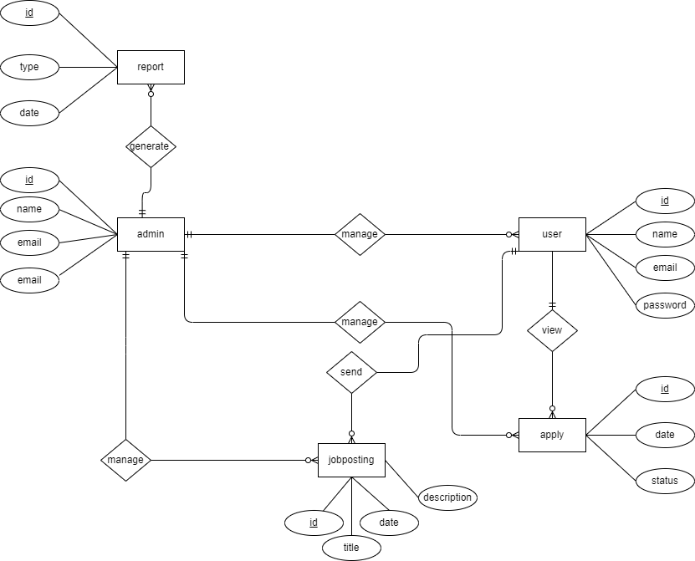
ERD DIAGRAM

Slide 8
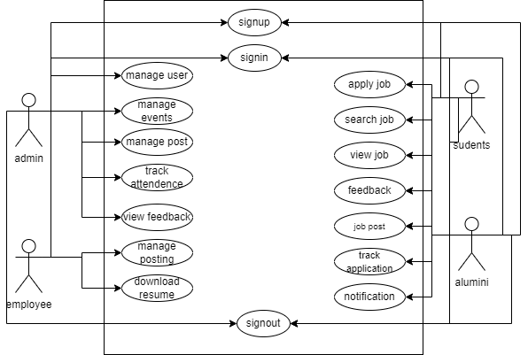
Use Case Diagram:

Slide 9
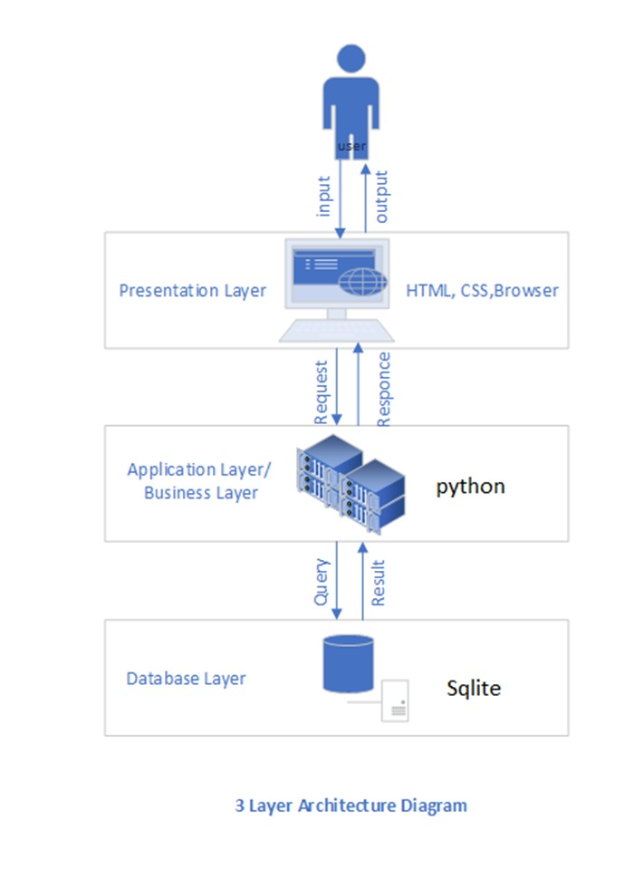
Architectural Design:

Slide 10
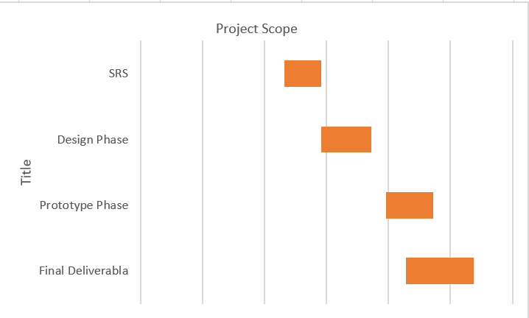
Project Schedule:

Slide 11
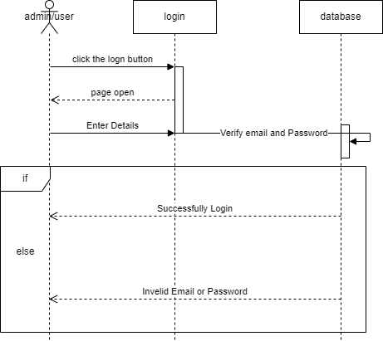
Sequence Diagrams:

Slide 12
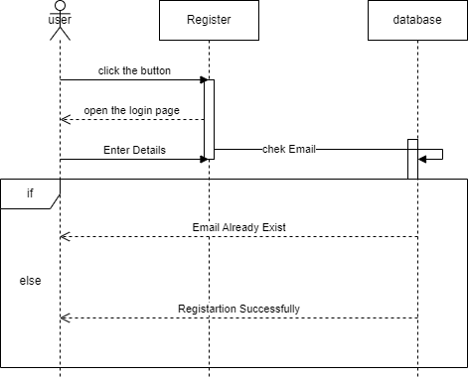

Slide 13
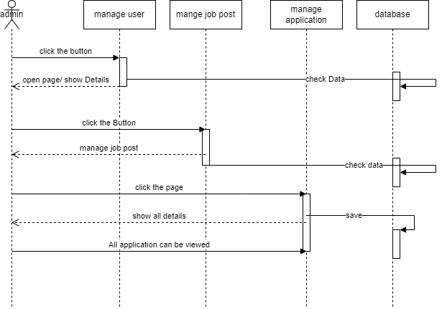

Slide 14
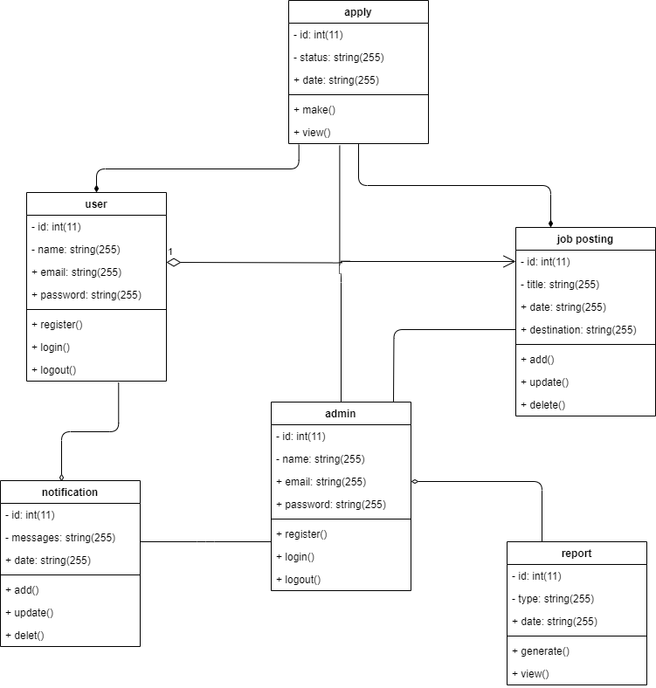
Class Diagram

Slide 15
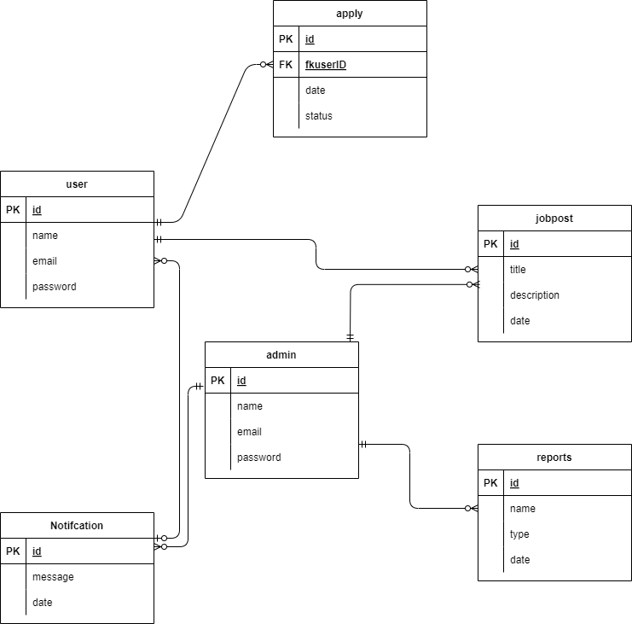
Database Diagram:

Slide 16
PROJECT TOOLS
HTML
CSS
BOOTSTRAP
Python

Slide 17
THANK YOU Sir!

